Slide 1
DNA and Surname Studies
Elizabeth (Blake) Kipp, PLCGS
Member #1004

Slide 2
Beginnings….
Feel free at any time to send in queries during the hangout if I am able to answer them now I will do so
Some useful books for DNA and Surname Studies
Genetic Genealogy: The Basics and Beyond. Emily D Aulicino, AuthorHouse LLC, 2014. ISBN 978-1-4918-4090-0.
The Surnames Handbook: A guide to family name research in the 21st Century. Debbie Kennett, The History Press, 2012. ISBN 978-0-7524-6862-4
Surnames, DNA, and Family History. George Redmonds, Turi King and David Hey, Oxford University Press, 2011. ISBN 978-0-19-958264-8

Slide 3
DNA Testing – comments I make to people asking about testing
Be prepared to understand that the results of DNA testing may not be what you expect
I would recommend waiting to test until you are ready to see the results; they tell you your deep ancestry which may or may not be as you believe
They reveal to you any non paternal events that may have occurred in the ancestral past (Y DNA)
There may be matches that are quite unexpected (autosomal DNA)

Slide 4
Abbreviations
Y DNA – male line of DNA that is passed father to son
mt DNA – female line of DNA that is passed mother to child, only females will pass on their mt DNA to their offspring
at DNA – autosomal DNA (the 22 chromosomes passed from parents to child at conception (“matched pairs” one from each parent)
X DNA – X chromosome, a female receives 2 one from each parent and a male receives one only from his mother (from father he receives Y DNA as the “matched pair”)

Slide 5
Testing Companies I have used
National Genographic Project (1.0 and 2.0)
Sorenson Genographic Project
FT DNA (yDNA, mtDNA, atDNA (includes X chromosome))
Ethnoancestry (Snps)
BritainsDNA (Chromo 2 Plus) (acquired Ethnoancestry)
AncestryDNA (atDNA)
23 and Me (yDNA, mtDNA, atDNA (includes X chromosome))

Slide 6
Surname Studies – who to test
Anyone willing to test that carries the surname you are interested in including males and females.
Anyone with the surname in the last couple of generations (I generally say that past your 3x great grandparents you may not see a lot of matching with atDNA).
I tend to not pay for other people to test. A surname like BLAKE has so many founding lines. My other surname PINCOMBE I might pay to test in particular lines but tend not to offer to do so.
I think the more people in a project the greater are the chances of people testing especially if there are different haplogroups.

Slide 7
Summary
Overview of yDNA, mtDNA, atDNA, X chromosome DNA
Case studies
Benefits of yDNA and atDNA for one name studies

Slide 8
Four types of DNA
Y DNA
X DNA
atDNA (other 22 chromosomes)
mtDNA

Slide 9
Y DNA – Male line
Y DNA is passed from father to son and in essence one could travel back along the strictly male line in a particular surname and see the same DNA results for the alleles as measured by testing companies right back to the first male who carried the signature (sometimes exact but often with a few mutations thus helping to separate out sons)
In the case of male children of a daughter of this surname who retains the surname of his mother the male would not likely be carrying the genetic signature of the surname and thus the line would be broken although the surname would be the same thus creating a new surname Y DNA line

Slide 10
At DNA – Every ancestor can contribute
Autosomal DNA contains the pieces of our past that have been passed on to us from our many many ancestors through our parents – 50% from the father and 50% from the mother (looking only at the 22 chromosomes and excluding the X chromosome in this notation of 50%)
We may receive as little as 0% or as much as 25% from each of our grandparents with 50% coming from our paternal and 50% from our maternal side through our parents

Slide 11
X chromosome DNA
Males receive one X chromosome only and this is from their mother and is a blend of the X chromosome that she received from her mother and the X chromosome from her father which is the same X chromosome that he received from his mother
Not really useful for Surname Studies like a Y chromosome but could be interesting

Slide 12
Mt DNA – Female line
Mt DNA is passed from a mother to her children but only her daughters will pass on her mt DNA to their children. Male children of the family who marry will have children who carry their wife’s mt DNA
Not useful for surname projects particularly but can be interesting looking at a family for whom the geographic location is unknown but not always helpful in that regard

Slide 13
CASE STUDIES – Y DNA and At DNA
Kipp/Kip one name study
Pincombe/Pinkham one name study
Blake/Bleak one name study

Slide 14
Y DNA/At DNA - KIPP one name study
KIPP/KIP
Ongoing study at FT DNA since 2009
Purpose was to find the genetic signature for the different Kipp/Kip families worldwide
One KIP family came from Amsterdam Holland in the mid 1630s to late 1630s to New Amsterdam (aka New York City). This family in particular has been given a known signature.
Three KIPP emigrants to the United States from the Germanic States in the mid 1700s (two different sets of signatures)

Slide 15
Y DNA/At DNA - KIPP one name study
At DNA permits females with the Kipp/Kip surname to participate
Y DNA permitted the separation of Kipp/Kip families
One tester currently living in an area where the emigrant KIPP/KIP families lived in Europe does not match any of the emigrant families (known ancestry back into the 1700s is from a Germanic State) nor does he match the other KIPP lines
Not a singleton surname

Slide 16
KIPP/KIP yDNA Study
(New Amsterdam descendants sample)
13 23 14 11 11-14 13 12 12 13 13 29
13 23 14 11 11-14 13 12 12 13 13 29 36-38
13 23 14 11 11-14 13 12 12 13 13 29 36-38
13 23 14 11 11-14 13 12 12 13 13 29 36-39
13 23 14 11 11-14 13 12 12 13 13 29 37-38

Slide 17
Summary for KIPP/KIP family
KIPP/KIP family of New Amsterdam has a distinctive value of 13 at DYS426
KIPP/KIP family #1 of Pennsylvania has the value of 12 at DYS426 (usual value). They are also separate from the New Amsterdam family by a GD of 6 or 7 on 37 markers.
KIPP one name study has discovered that this New Amsterdam KIPP/KIP family has its origins (prior to 1600) in the area where the borders of Denmark/Netherlands/Germany come together

Slide 18
Surname Projects versus Haplogroup projects
Recommend that members of a surname project join the relevant haplogroup project
Surname projects could look at deep ancestry but the haplogroup projects are much more efficient at deep ancestry
Leaves the administrator of the surname project free to concentrate on understanding changes in the allele values in family groupings helping to separate out lines

Slide 19
Y DNA/At DNA –PINCOMBE/PINKHAM one name study
Known 5th cousin tested (descendant of the PINCOMBE family found at Bishops Nympton and North Molton, Devon back to 1485)
Two PINKHAM members tested and did not match each other nor did they match the known 5th cousin
Contact in Sweden with known history back to the early 1700s in Sweden matches known 5th cousin
Son of William PINCOMBE known to be in “foreign parts” from William’s will dated 1602, the name of the Swedish ancestor is “son of Peter” William’s son Simon is the one in foreign parts but he also had a son Peter that cannot be traced down in Devon

Slide 20
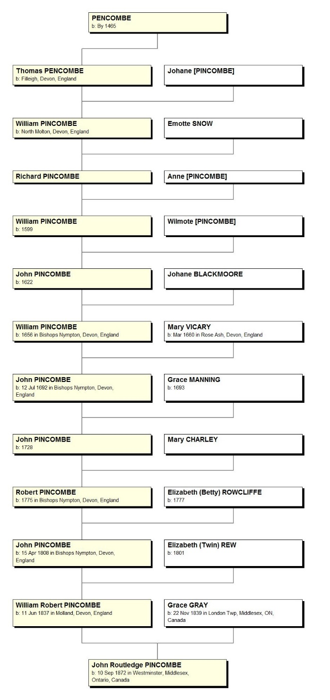
PINCOMBE Family Tree yDNA line at Bishops Nympton/North Molton, Devon

Slide 21
Problems with yDNA single surname studies
Small group of testers with a known singleton surname and no matches
Known history of the PINCOMBE/PENCOMBE surname places it at North Molton, Devon circa 1485
Surname PENCOMBE found in Bromyord, Herefordshire back to the 1300s
Surname PINKHAM found in Devon/Cornwall earlier than 1485

Slide 22
Conflict between established research and Y DNA results
PINCOMBE/PINKHAM one name study was begun by Dr Richard PINKHAM (Gloucestershire) prior to World War II
14 bulletin board sized charts of family trees for various areas in Devon, London, and America
How to reconcile when the Y DNA does not match
Undoing 50+ years of research?
Wait and see

Slide 23
Resolution of non-matching members
Let the study sit for awhile but continue to advertise for more testers
Collect early references to the surname to understand its possible multiple origins if any
Write up/blog on this early history to make the surname more visible
Family Finder testing to help find matches (females wanting to be part of the surname study can contribute)
Be lucky, the surname match with someone in Sweden able to trace back to the early 1700s and his haplogroup is uncommon in Sweden

Slide 24
Using atDNA to look at surname matches
Two sets of PINCOMBE matches with the same individual known to be a 4th cousin at FT DNA Family Finder and AncestryDNA (3x great grandparents in common)
One match with a known PINCOMBE third cousin once removed (2x great grandparents in common)
Finding matches in the PINCOMBE family descendant of John PINCOMBE and Johane BLACKMOORE is my next step (gradually working backwards in time helps to prove particular lines)

Slide 25
Y DNA/At DNA – BLAKE one name study
Ongoing project since 2004, one name study initiated in 2011
Some separation of lines has led to interesting results but more testers are needed to really determine the roots of some of the lines
Project at 50+ members is still fairly limited
Plans continue to recruit more members
Blake Newsletter published 4 times a year and DNA progress reported which has resulted in several new testers each year

Slide 26
Y DNA/At DNA – BLAKE one name study
More than 60% of the members of the project managing a particular set of data are female
Family Finder at FT DNA has proven to be quite useful in that females can also test their atDNA within a surname project adding to the knowledge of a particular line.
Thus far Family Finder has not proven to be significant in the BLAKE one name study

Slide 27
CASE STUDIES – At DNA and one name studies
PARLEE/ALLEN/FOLKINS
Considering doing a Family Finder study on the descendants of three families where there is considerable intermarriage between cousins
Use GedMatch with a single surname study to find individuals who have tested at 23 and Me, AncestryDNA or FT DNA and match on particular chromosomes

Slide 28
At DNA – PARLEE/ALLEN/FOLKINS families
Large United Empire Loyalist families in New Brunswick arrived following the withdrawal of the British garrison from New York City
Family Finder at FT DNA permits you to bring your matches into Chromosome Browser thus letting you see exactly where you match
Name particular areas on the Chromosome as “one name”
Use that process for any new matches that list these ancestral families to determine the line that you are matching on
Consider setting up a project for descendants of a particular couple at FT DNA with a particular surname being the focus

Slide 29
Mt DNA – haplogroup projects
T haplogroup project at FT DNA looking at the Full Genetic Scan of several hundred people was able to produce a new index for T haplogroup and its subclades which was published in the International Society of Genetic Genealogists Journal (e-journal) (Administrator T2 project, Co-administrator T_FGS project, Co-author of paper)
H11 haplogroup project looking at the Full Genetic Scan of over a hundred people has been able to determine likely geographic locations for some of the subclades (unpublished) (Administrator H11 project FT DNA)

Slide 30
H11 haplogroup (about 1% of H)
H11 T8448C G13759A T16311C!
  H11a T961g A16293G
    H11a1 C8898T C16278T! Europe
    H11a2 A14587G (T16092C) Europe
      H11a2a T16140C Europe
        H11a2a1 A3145G NW Europe
        H11a2a2 G5585A T15670C A16265G E Europe
        H11a2a3 C9521T Europe
    H11a3 T16243C Europe
    H11a4 5899.XC C16111T Europe
    H11a5 C15040T
    H11a6 G1719A G5979A A16525G Europe
    T152C!
      H11a7 C9911T Europe
  H11b T13572C
  H11b1 T7645C E to Central Europe

Slide 31
CASE STUDIES – MtDNA
Not particularly beneficial to surname studies as they trace the female line
If a location can be determined may be helpful looking at emigrant studies if married when they emigrated and place of origin is unknown

Slide 32
X chromosome studies
This along with mtDNA are the least useful in Surname Studies
Males have a limited number of individuals who will match them on the X chromosome studies compared to females
Could prove to be useful in separating lines, still investigating

Slide 33
Y DNA and one name studies
Benefits
Drawbacks
Attracting members
Publishing results

Slide 34
Queries
Please send any queries to kippeeb@rogers.com and I will reply to them, if possible, after the Hangout in the next edition of The Surname Scribbler

Slide 35
Books suggested
Genetic Genealogy: The Basics and Beyond. Emily D Aulicino, AuthorHouse LLC, 2014. ISBN 978-1-4918-4090-0.
The Surnames Handbook: A guide to family name research in the 21st Century. Debbie Kennett, The History Press, 2012. ISBN 978-0-7524-6862-4
Surnames, DNA, and Family History. George Redmonds, Turi King and David Hey. Oxford University Press, 2011. ISBN 978-0-19-958264-8

Slide 36
Questions
Thank you

